Slide 1

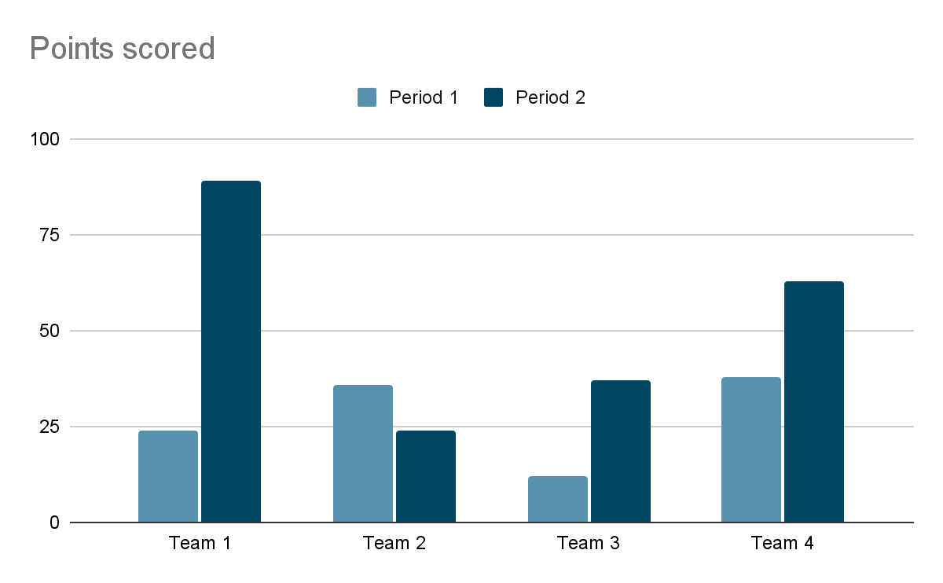
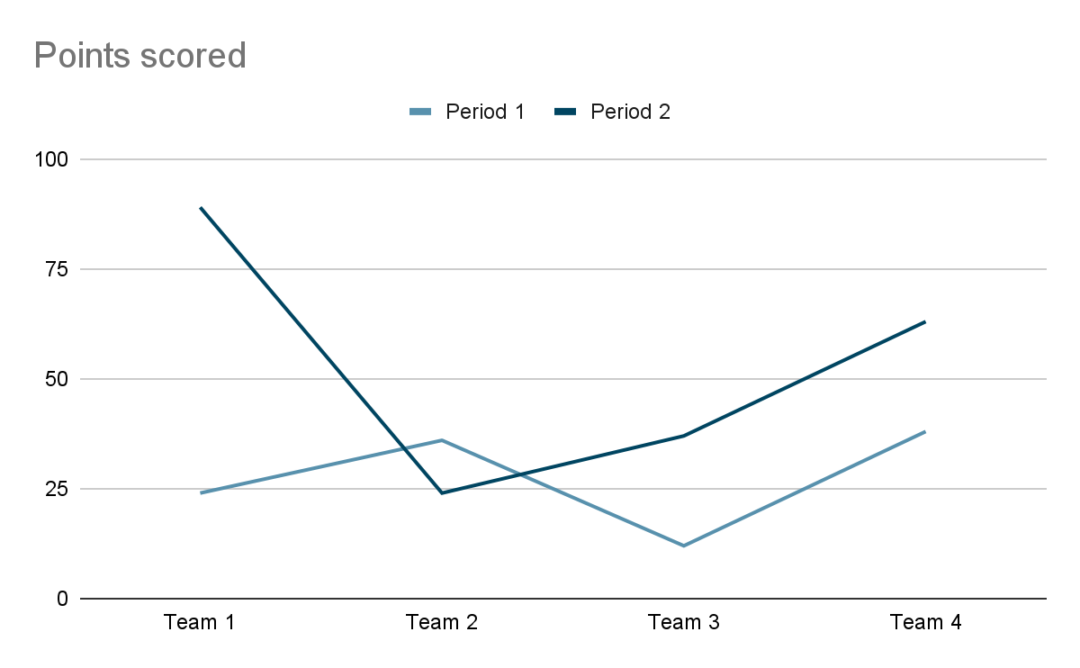
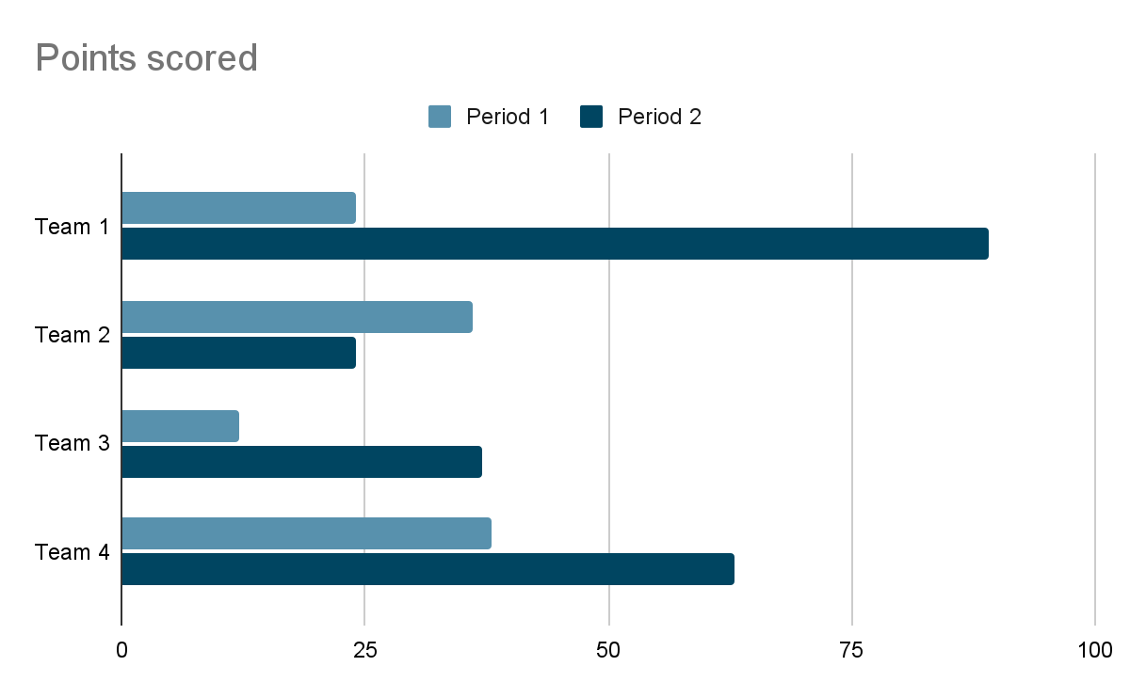
An AI Companion for Developers to Tune
Complex Technologies
Yusuf Suat Polat
Onur Dilsiz
Supervisor: Bahri Atay Özgövde
Co-Supervisor: Yunus Durmuş
Introduction
-what is spark:
Spark is this. Used for this. Used by this percentage in companies.
-what are cases. why?
There are some cases. We should optimize them.
case 1
case 2
case 3
case 4
Prompt(All vs onebyone) graph with different models
token vs success
Short information
SUCCESS_VS_COST_GRAPH.JPG
latency vs model
SPARK_UI.JPG
Methodology
We are utilizing an llm to inspect the metrics of the Apache Spark applications. The pipeline of our companion is as follows:
Asking for code file or the UI screenshots from the user
If the code is provided, the prompts about the above mentioned cases are applied.
Then, we are generating an analysis rapor for the user which shows the parts of the code that may underperform, and suggests the changes.
If the screenshots are provided, the analysis is done by the llm using the UI prompt.
Future Work
Spark UI will also be included in future work
Architecture.JPG
References

